Slide 1
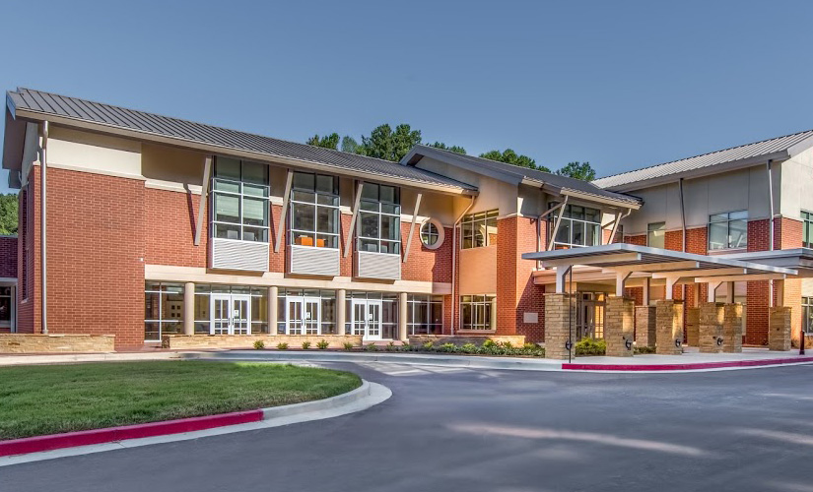
WELCOME TO 3rd GRADE AT HFES! 2018-2019
Mrs. Kristi Redwine

Slide 2
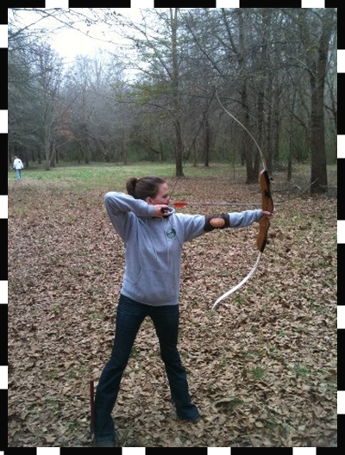
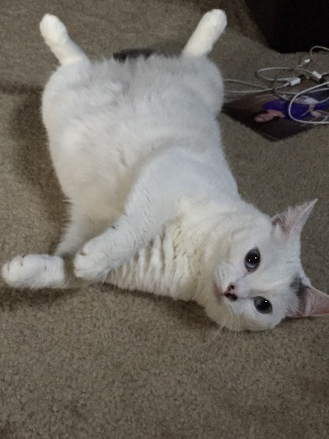
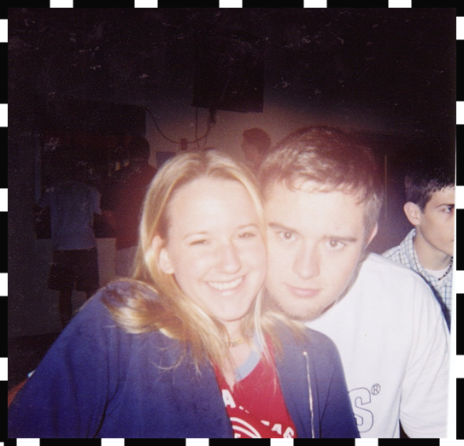
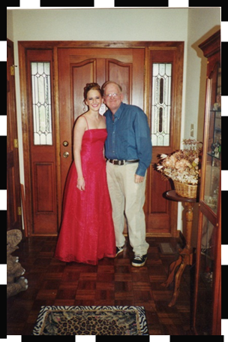
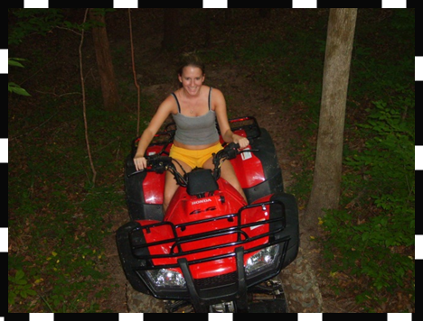
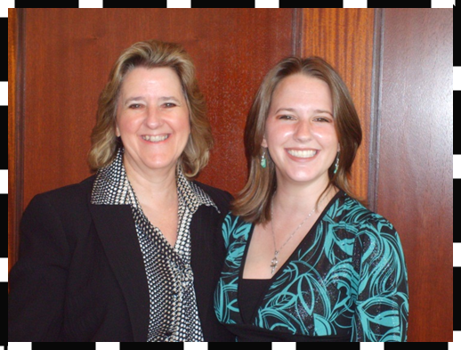
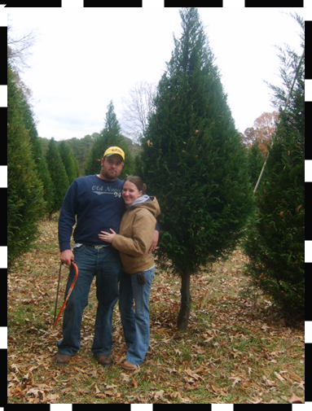
A little bit about me!

Slide 3
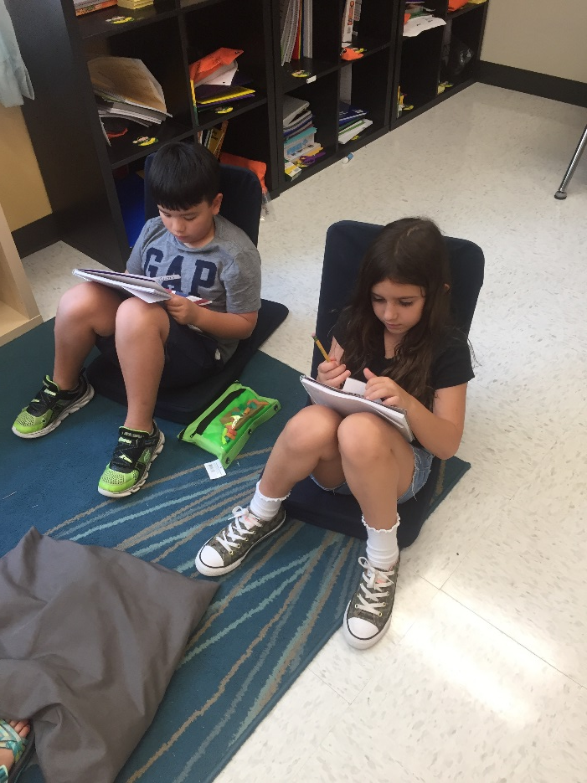
Daily Schedule
7:10-7:40am Homeroom/ Morning Work
7:40-8:10am Team Time
8:10-9:30am Math Inquiry
9:30-10:00am Recess
10:00-10:55am Reading Inquiry
10:55-11:25pm Lunch
11:30-12:35pm ELA Inquiry
12:35-1:20pm Specials*
1:20-1:35pm Read aloud
1:35-2:05pm Science/ Social Studies Inquiry
2:15-2:20pm Pack Up/ Dismissal
*Specials:
Monday: P.E.
Tuesday: Art
Wednesday: PE
Thursday: Music
Friday: Spanish

Slide 4
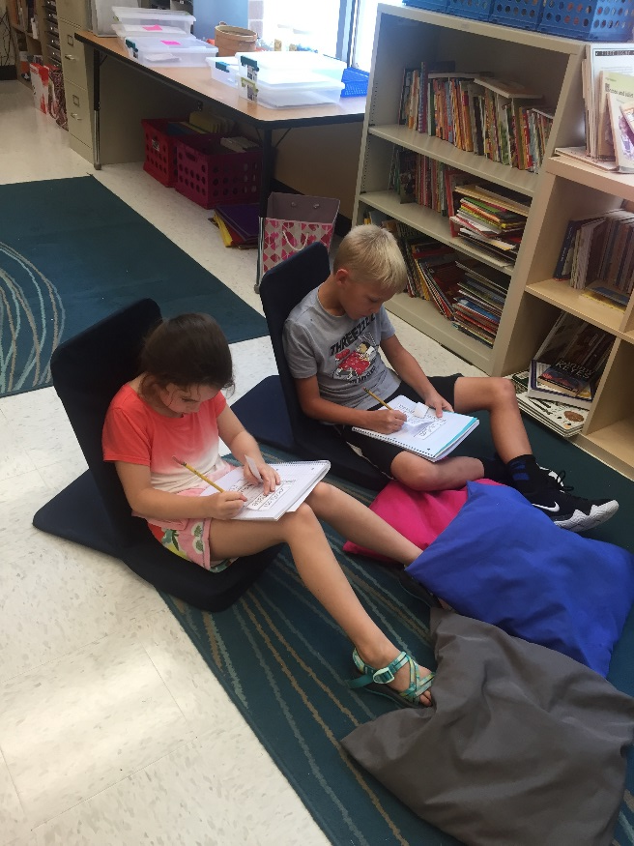
Communicating with me
Email: redwinek@fultonschools.org
Redwinethird.weebly.com
By phone: 470-254-6190

Slide 5
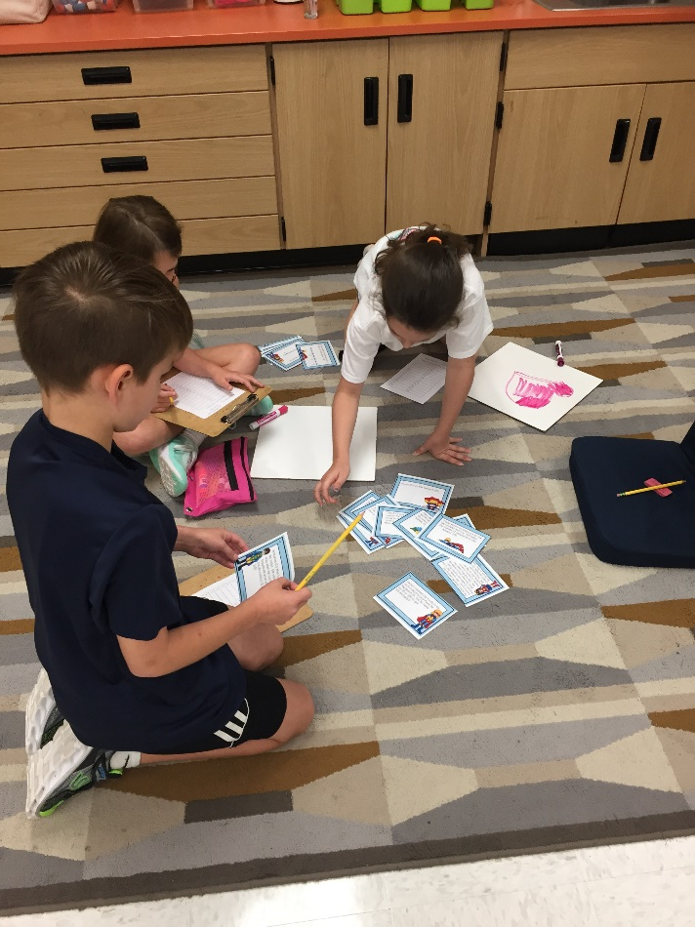
How I will communicate with you
Monthly Newsletters
Thursday Folders
Agenda
Email
Weebly:
redwinethird.weebly.com

Slide 6
Attendance (School-wide)
Third Grade is a BIG year! We COMPLETELY understand that children get sick and families enjoy their time together. PLEASE try to limit your child’s non medical time away from school as much as you can. The homework will always be on the Weebly for them to work on and classwork will be worked on in class when they return. Thank you SO much for understanding! ☺
Please send a hand written note or email explaining your child’s absence to school the day your child returns!
Transportation changes must be sent in with your student the morning the change is made.
Information on absences and transportation are in the front of the agenda.

Slide 7
Organization for Classes
Folders: EVERYTHING will stay in these folders- one per subject area- if you take anything out of the folders, please make sure it’s returned in there before the next school day. ☺
LA/WRITING- Yellow
MATH- Blue
SCIENCE- Green
SOCIAL STUDIES- Purple
READING- Red
Notebooks will stay in their cubby unless they come home for studying purposes.
Homework should always be written in agenda each Monday and changes will be made as needed.

Slide 8
Homework
It is the student’s responsibility to plan ahead in order to turn in homework on time.
Homework is written in the student’s agenda each Monday throughout the day.
Homework is always due the following school day unless the “due date” is posted.

Slide 9
Parent Volunteers
We LOVE our parent volunteers!
Our homeroom’s Room Moms will be coordinating the volunteers. Please visit our class website to sign up:
https://mrsredwines3rdgradeclass20182019.shutterfly.com/
Our Room Moms are:
Barbara Smallwood: barbiegirlrdh@yahoo.com
Carol Totten: caztotten@me.com
Please make sure that if you are planning to come in and volunteer then you have completed the Online Volunteer Procedures.

Slide 10
Grading Policy
All grades will be posted on the (HAC) Home Access Center for you to view throughout the year. Grades 3-5 will be using a Standards Based Report Card.
If you have not received your ID or password please see Mrs. Julia with a valid ID to receive this information.
Grades:
Assessments and Performance Assessments : 30%
Quizzes: 25%
Classwork/Projects : 45%

Slide 11
Grading Policy Continued
Make Up Work: If your child is absent, they will make up their classwork on the day they return to school.
Late Work: Students will lose 2 points per day that the assignment is late- 10 point max (5 days late). If the student does not put their name on their paper- they will also lose 5 points.
Not completed work: Will be entered in to HAC as an NHI (Not Handed In), this is the equivalent to a 50%. Students will be reminded of any missing assignments.

Slide 12
Standardized Testing
ITBS is October 22-26th.
Georgia Milestones is April 11th-May 25th.
FastBridge Universal Screener- Fall, Winter, and Spring
During these weeks students will not have any homework. Please allow them to get plenty of sleep, a good dinner, and a good breakfast! ☺

Slide 13
Positive Behavior- High 5!
Whole Group: The students work for class gems, once they fill the jar up, then they vote on a class reward.
Table Groups: The students work as a table team to earn gems. Once the table fills up their jar, they vote on a table reward.
Individual: The students move their clips up the High 5 chart- when they reach High 5, I wear their clip for the day. After 3 High 5’s they get a prize from the Treasure Box. ☺
PBIS- Eagle Points ( class and individual)
Notes:
The system that we are using in 3rd grade is based on positive reinforcement and is linked to our school wide behavior management system using the behavior matrix. The behavior matrix divides the school into setting (classroom, hallway, bathroom, cafeteria, etc). Each setting displays the expectations of the students.

Slide 14
International Baccalaureate (IB)
Attitudes
Appreciation
Commitment
Confidence
Cooperation
Creativity
Curiosity
Empathy
Enthusiasm
Independence
Integrity
Respect
Tolerance
Learner Profiles
Caring
Communicator
Inquirer
Knowledgeable
Open-minded
Principled
Reflective
Risk-taker
Thinker
Balanced

Slide 15
I.B. Continued
Globally minded teaching
Transdisciplinary Themes
Who We Are
Where We Are In Place and Time
How We Express Ourselves
How the World Works
How WE Organize Ourselves
Sharing The Planet

Slide 16
Digital Citizenship

Slide 17
Math
Rigor
Explain what you are thinking. Using words, pictures, numbers, equations, etc.
Depth of Knowledge
Example: Allowing the students to try to figure it out first before coming together to discuss what they learned.
The units are multiple concepts that build upon each other.
We do use iReady Math.

Slide 18
Science
There are five units in Third Grade science.
Habitats in Georgia
Pollution and Conservation
Rocks and Minerals
Fossils
Heat
Science and Social Studies will be taught interchangeably throughout the year.

Slide 19
Literacy: Reading and Writing
By the time students enter 3rd grade, they are no longer learning to read but reading to learn.
*Balanced Literacy Framework-teaching all parts of literacy including reading, writing, grammar, spelling, vocabulary
*Guided Reading/Writing-teaching reading/writing through small groups within that group’s level
*Independent Reading/Writing-student reading/writing and responding to what they are reading on their individual level and conferencing with the teacher
*Fountas and Pinnell-a research based leveling program for reading (both assessments and book levels)

Slide 20
Social Studies
In Third Grade Social Studies there are eleven units of study.
Government
Economy
Native Americans
British Colonial America
Explorers
Topographical features on a map of the United States.

Slide 21
Parent Conferences
Please sign up for a conference time with me on the table in front of the window. ☺
If your child goes to another teacher, the teacher will pass any information on to the homeroom teacher. They will ensure the homeroom teacher has this information prior to your conference.

Slide 22
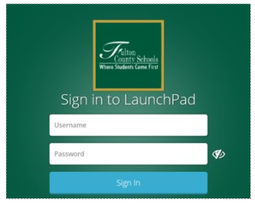
Online Resources
​
iReady Reading​
iReady Math
How to sign in to Launchpad

Slide 23
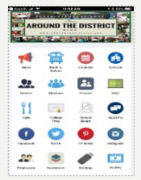
How to use quicktip
Install the Fulton County Schools App in Android or Apple Device​
Select the “QuickTip” icon on the App.​
You will see a form to choose your school and enter your message or “tip.”​
Click “submit”​
Safety & Security will receive the message immediately and begin working with schools and departments to verify and resolve reported issues.​
Contact information is optional.​
See an issue? Report it! Let’s work together to keep our schools safe.

Slide 24
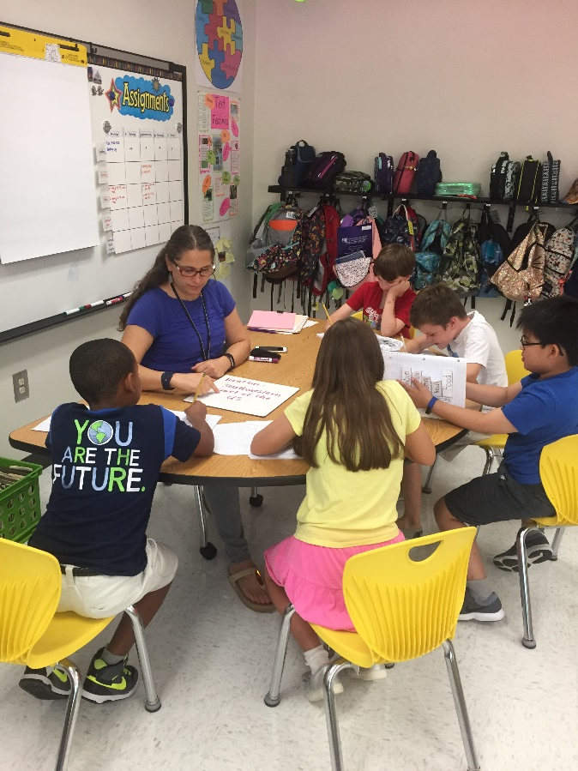
Questions and Important Websites
Thank you so much for coming!! ☺
Please sign up for a conference
before you leave!
www.georgiastandards.org
The state standards for each
grade-level.

